Slide 1
Multiarea OSPF for CCNA
Lonnie Decker
Department Chair, Networking/Information Assurance
Davenport University, Michigan
Elaine Horn
Cisco Academy Instructor
August 2013

Slide 2
Objectives
Review OSPF Single Area
Multiarea OSPF Implementation
Types of LSAs Exchanged Between Areas
Configuring Multiarea OSPFv2 and OSPFv3
Verifying an OSPFv2 and OSPFv3 Configuration
Review OSPF Key Points
Notes:
OSPFv2 – IPv4 network addressing
OSPFv3 – IPv6 network addressing

Slide 3
OSPF Single Area - Review
Notes:
It is important the you understand OSPF single area concepts and configuration before beginning the study of multi-area OSPF.

Slide 4
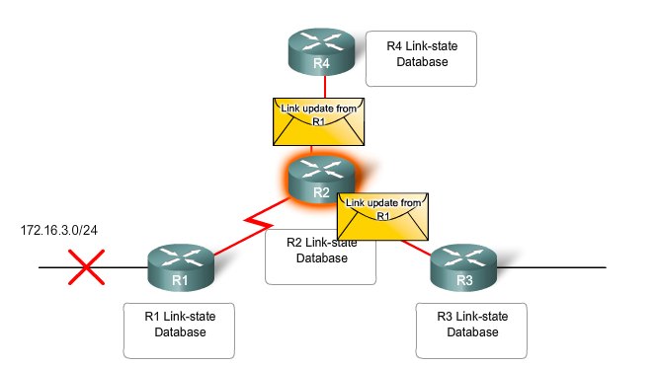
OSPF Single Area - Review
Link State Routing Protocol
Faster Convergence
Cost Metric (Cisco – Bandwidth)
Identical Link-State Databases (LSDBs)
SPF – Dijkstra’s Algorithm
Determine Neighbors on Directly-connected links
Use Link-State Packets (LSP) for each directly-connected link
Flood LSPs to neighbors
Notes:
As a review, OSPF (Open Shortest Path First) is a Link State Routing Protocol with an Administrative distance (AD) of 110.
(AD = trustworthiness or preference of the routing protocol.) OSPF is classless; therefore, it supports VLSM and CIDR.
OSPF quickly propagates network changes. Routing changes trigger OSPF routing updates so it is more efficient than distant vector routing protocols such as RIPv2. (RIPv2 uses periodic updates of every 30 seconds.)
In OSPF, The cost of a link is based on bandwidth only. Higher bandwidths will have a lower cost.
OSPF creates and maintains three databases:
Adjacency database - Creates the neighbor table
Link-state database (LSDB) - Creates the topology table
Forwarding database - Creates the routing table
These tables contain a list of neighboring routers to exchange routing information with and are kept and maintained in RAM.
Once the network is converged all routers in an area will have identical link-state databases!
OSPF uses the Shortest Path First algorithm to choose the best path. The CPU processes the neighbor and topology tables using Dijkstra’s SPF algorithm This algorithm is based on the cumulative cost to reach a destination. The SPF algorithm creates an SPF tree by placing each router at the root of the tree and calculating the shortest path to each node. The SPF tree is then used to calculate the best routes. OSPF places the best routes into the forwarding database, which is used to make the routing table.
OSPF uses link-state packets (LSPs) to establish and maintain neighbor adjacencies and exchange routing updates. LSPs represent the state of a router and its links to the rest of the network.

Slide 5
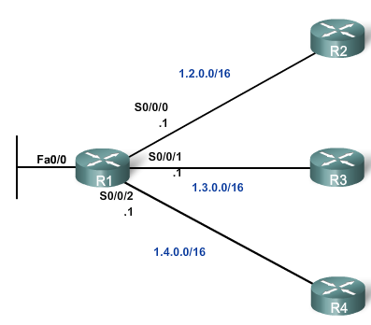
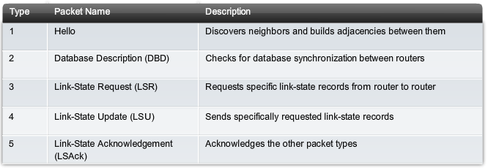
OSPF Packet Types
Type 1 - Hello
Type 2 - Database Description (DBD)
Type 3 - Link-State Request (LSR)
Type 4 - Link-State Update (LSU) – Multiple Types
Type 5 - Link-State Acknowledgement (LSAck)
Notes:
OSPF exchanges messages to convey routing information using five types of packets. These packets are:
Hello packet
Database description packet
Link-state request packet
Link-state update packet
Link-state acknowledgment packet
These packets are used to discover neighboring routers and also to exchange routing information to maintain accurate information about the network.

Slide 6
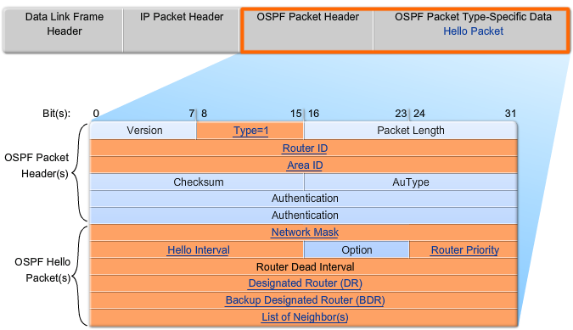
OSPF – Hello Packet
Discover OSPF Neighbors
Establish Neighbor Adjacencies
Advertise Parameters
Hello Interval (Default 10 or 30 seconds)
Dead Interval (Default 4 x Hello)
Network Type
Elect DR & BDR (multi-access network)
Notes:
Let’s look at the Hello Packet
The OSPF Type 1 packet is the Hello packet. Hello packets are used to:
Discover OSPF neighbors and establish neighbor adjacencies.
Advertise parameters on which two routers must agree to become neighbors.
Hello Packets are also used to Elect the Designated Router (DR) and Backup Designated Router (BDR) on multiaccess networks like Ethernet and Frame Relay. Just a reminder…Point-to-point links do not require DR or BDR.
The figure displays the fields contained in the Type 1 Hello packet. Important fields shown in the figure include:
Type - Identifies the type of packet. A one (1) indicates a Hello packet. A value 2 identifies a DBDescription packet, 3 an LSRequest packet, 4 an LSUpdate packet, and 5 an LSAck packet.
Router ID - A 32-bit value expressed in dotted decimal notation used to uniquely identify the originating router. (an IPv4 address)
Area ID - Area from which the packet originated.
Network Mask - Subnet mask associated with the sending interface.
Hello Interval - Specifies the frequency, in seconds, at which a router sends Hello packets. The default Hello interval on multiaccess networks is 10 seconds. This timer must be the same on neighboring routers; otherwise, an adjacency is not established.
Router Priority - Used in a DR/BDR election. The default priority for all OSPF routers is 1, but can be manually altered from 0 to 255. The higher the value, the more likely the router becomes the DR on the link.
Dead Interval - Is the time in seconds that a router waits to hear from a neighbor before declaring the neighboring router out of service. By default, the router Dead Interval is four times the Hello interval. This timer must be the same on neighboring routers; otherwise, an adjacency is not established.
Designated Router (DR) - Router ID of the DR.
Backup Designated Router (BDR) - Router ID of the BDR.
List of Neighbors - List that identifies the router IDs of all adjacent routers.

Slide 7
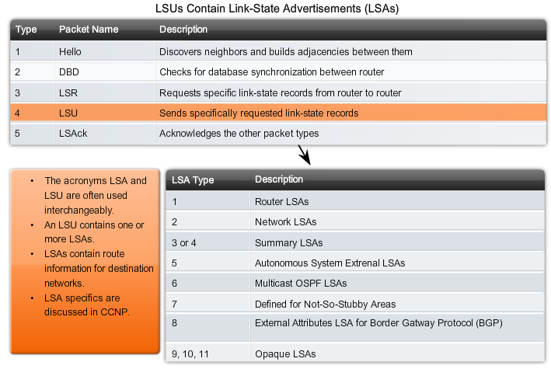
OSPF – Link State Updates (LSU)
Link-State Update (LSU)
Link-State Advertisement (LSA)
(Interchangeable)
Multiple LSA Types
Notes:
Type 4: Link-State Update (LSU) packet - Used to reply to LSRequests (type 3) and to announce new information. LSUs can be one of 11 different types of LSAs. LSUs are sometimes referred to as LSAs. Only the first 5 LSA types are covered on the CCNA.

Slide 8
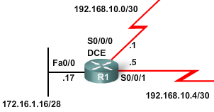
Basic OSPF Configuration
R1(config)#int fa 0/0
R1(config-if)#ip address 172.16.1.17 255.255.255.240
R1(config)#int s 0/0/0
R1(config-if)#ip address 192.168.10.1 255.255.255.252
R1(config)#int s 0/0/1
R1(config-if)#ip address 192.168.10.5 255.255.255.252
R1(config-if)#router ospf 1
R1(config-router)#network 172.16.1.16 0.0.0.15 area 0
R1(config-router)#network 192.168.10.0 0.0.0.3 area 0
R1(config-router)#network 192.168.10.4 0.0.0.3 area 0
Command syntax:
router ospf process-id
network network-address wildcard-mask area area-id
Notes:
This is a basic single area OSPF configuration
Interfaces are configured and then networks are advertised. The wildcard mask is used to identify which bits in the network address are significant. The network 172.16.1.16/28 will be advertised as 172.16.1.16 0.0.0.15. This wildcard mask is the inverse of the subnet mask, 255.255.255.240. Notice the subnet mask for /30 is 255.255.255.252 and the wildcard mask used to advertise this network is 0.0.0.3. (255.255.255.255 – 255.255.255.252 = 0.0.0.3)

Slide 9
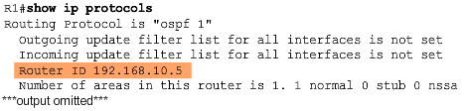
OSPF Router ID
Router ID = 192.168.10.5
Use the IP address configured with the OSPF router-id command.
If the router-id is not configured, the router chooses highest IP address of any of its loopback interfaces.
If no loopback interfaces are configured, the router chooses highest active IP address of any of its physical interfaces.
Verification
Notes:
Every router requires a router ID to participate in an OSPF domain. The router ID can be defined by an administrator or automatically assigned by the router.
The router ID is used by the OSPF-enabled router to:
Uniquely identify the router
Participate in the election of the DR and BDR
Let’s review how to determine the router ID? As illustrated in the figure, Cisco routers derive the router ID based on one of three criteria, in the following order:
The router ID is configured using the OSPF router-id rid router configuration mode command. The rid value is any 32-bit value expressed as an IPv4 address. This is the recommended method to assign a router ID. (Example: 1.1.1.1)
If the router ID is not configured, the router chooses the highest IPv4 address of any of configured loopback interfaces. This is the next best alternative to assigning a router ID.
If no loopback interfaces are configured, then the router chooses the highest active IPv4 address of any of its physical interfaces. This is the least recommended method because it makes it more difficult for administrators to distinguish between specific routers.

Slide 10
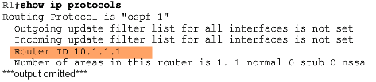
OSPF Router ID
Router ID = 10.1.1.1
R1(config)#interface loopback 0
R1(config-if)#ip address 10.1.1.1 255.255.255.255
R1(config)#router ospf 1
R1(config-router)#router-id 10.1.1.1
Reload or use "clear ip ospf process" command, for this to take effect
Verification
Notes:
Here is a sample configuration of a router-id. Once a router-id is set, you will need to either reload the router or use the command “clear ip ospf process” for this to take effect. Notice the router-id can be verified with the show ip protocols command.

Slide 11
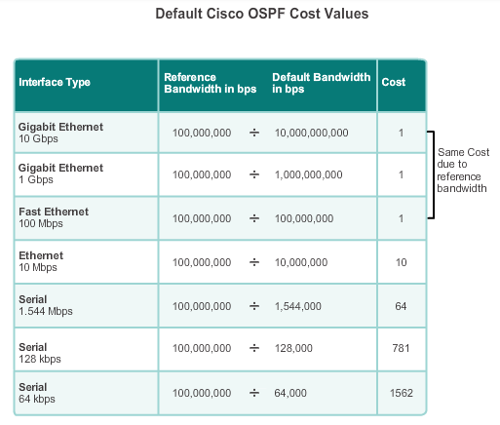
OSPF Metric - Cost
Cisco IOS uses the cumulative bandwidths of the outgoing interfaces from the router to the destination network as the cost value
Cost for an interface is calculated as 10 to the 8th power divided by bandwidth in bps
Results in interfaces with a bandwidth of 100 Mbps and higher having the same OSPF cost of 1
Reference bandwidth can be modified to accommodate networks with links faster than 100 Mbps using the OSPF command auto-cost reference-bandwidth
OR – Directly specify the cost for a link:
R1(config)#interface serial 0/0/0
R1(config-if)#ip ospf cost 1562
Notes:
OSPF uses cost as a metric. A lower cost indicates a better path than a higher cost. A 10-Mb/s Ethernet line has a higher cost than a 100-Mb/s Ethernet line.
The formula used to calculate the OSPF cost is:
Cost = reference bandwidth /interface bandwidth
The default reference bandwidth is 10^8 (100,000,000) as you can see in the graphic; therefore, the formula is:
Cost = 100,000,000 bps / interface bandwidth in bps
Refer to the table for a breakdown of the cost calculation. Notice that FastEthernet, Gigabit Ethernet, and 10 GigE interfaces share the same cost, because the OSPF cost value must be an integer. Consequently, because the default reference bandwidth is set to 100 Mb/s, all links that are faster than Fast Ethernet also have a cost of 1.
Reference bandwidth can be modified to accommodate networks with links faster than 100 Mbps using the OSPF command auto-cost reference-bandwidth
The “auto-cost reference-bandwidth” command must be configured on every router in the OSPF domain. The value is expressed in Mb/s; therefore, to adjust the costs for:
Gigabit Ethernet - auto-cost reference-bandwidth 1,000
10 Gigabit Ethernet - auto-cost reference-bandwidth 10,000
To return to the default reference bandwidth, use the auto-cost reference-bandwidth 100 command.
As seen in the last bullet, you do have the choice to define the cost that will be used in OSPF calculations with the interface command, ip ospf cost.

Slide 12
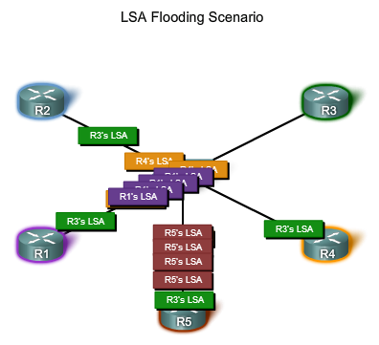
OSPF and Multiaccess Networks
Link-state routers flood their link-state packets when OSPF is initialized or when there is a change in the topology.
In a multiaccess network this flooding can become excessive.
On multiaccess networks, OSPF elects a Designated Router (DR) and a Backup Designated Router (BDR) in case the Designated Router fails.
All other routers become DROthers
DROthers only form full adjacencies with the DR and BDR in the network, and send their LSAs to the DR and BDR using the multicast address 224.0.0.6 (IPv6 FF02::06)
Notes:
The solution to managing the number of adjacencies and the flooding of LSAs on a multiaccess network is the DR. On multiaccess networks such as ethernet or frame relay, OSPF elects a DR to be the collection and distribution point for LSAs sent and received. A BDR is also elected in case the DR fails. All other routers become DROTHERs. A DROTHER is a router that is neither the DR nor the BDR.
DROthers only form full adjacencies with the DR and BDR in the network, and send their LSAs to the DR and BDR using the OSPF multicast address 224.0.0.6 (IPv6 FF02::06)

Slide 13
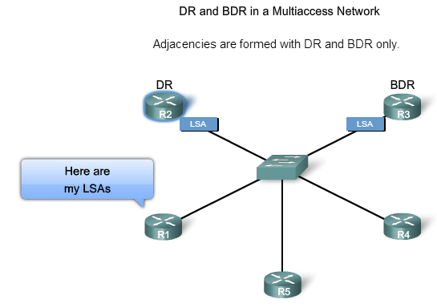
OSPF and Multiaccess Networks
DR/BDR Election
How do the DR and BDR get elected?
The following criteria are applied:
DR: Router with the highest OSPF interface priority.
BDR: Router with the second highest OSPF interface priority.
If OSPF interface priorities are equal, the highest router ID is used to break the tie.
Notes:
The following criteria are applied when electing a DR and BDR:
DR: Router with the highest OSPF interface priority. (All routers default to 1.)
BDR: Router with the second highest OSPF interface priority.
If OSPF interface priorities are equal, the highest router ID is used to break the tie.

Slide 14
Multiarea OSPF Implementation

Slide 15
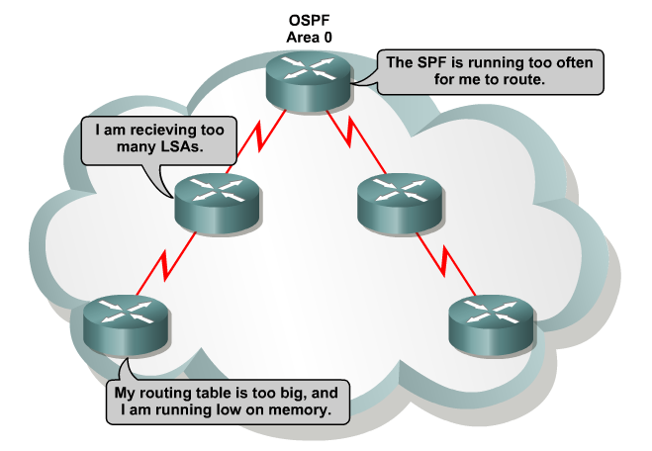
OSPF Issues with Large Networks
Frequent SPF algorithm calculations
Large routing table
Large LSDB
Solution:
Divide the network into multiple OSPF areas
Notes:
Frequent SPF algorithm calculations - In a large network, changes are inevitable, so the routers spend many CPU cycles recalculating the SPF algorithm and updating the routing table.
Large routing table - OSPF does not perform route summarization by default. If the routes are not summarized, the routing table can become very large, depending on the size of the network.
Large link-state database (LSDB) -Because the LSDB covers the topology of the entire network, each router must maintain an entry for every network in the area, even if not every route is selected for the routing table.
To make OSPF more efficient and scalable, the network can be divided into multiple OSPF areas. An OSPF area is a group of routers that share the same link-state information in their link-state databases.

Slide 16
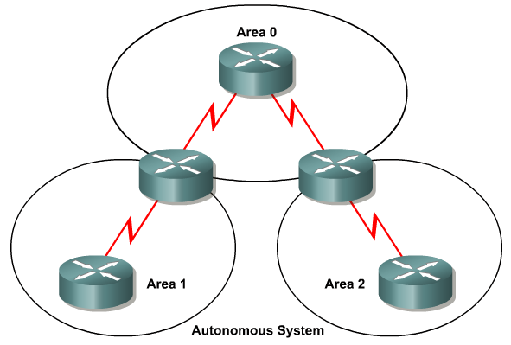
OSPF Areas
Reduced frequency of SPF calculations: Detailed route information exists within each area, link-state changes not flooded to other areas.
Smaller routing tables: Instead of advertising these explicit routes outside the area, routers can be configured to summarize the routes into one or more summary addresses.
Reduced LSU overhead: Rather than send an LSU about each network within an area, a router can advertise a single summarized route or small number of routes between areas.
Notes:
Multiarea OSPF have these advantages:
Reduced frequency of SPF calculations - Localizes impact of a topology change within an area. For instance, it minimizes routing update impact, because LSA flooding stops at the area boundary.
Smaller routing tables - There are fewer routing table entries as network addresses can be summarized between areas. For example, area 1 would summarize its routes and send them to area 0.
Reduced link-state update overhead- Minimizes processing and memory requirements, because there are fewer routers exchanging LSAs.

Slide 17
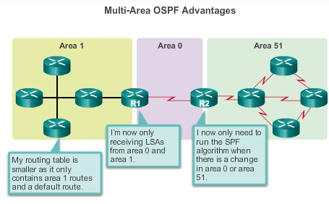
Why Multiarea OSPF?
Multiarea OSPF requires a hierarchical network design and the main area is called the backbone area (area 0) and all other areas must connect to the backbone area.
Notes:
Here we have an implementation of Multi-Area OSPF with 3 areas, area 1, area 0, and area 51. The result is smaller routing tables and less LSAs. SPF is only run within an area if there is a change in the network.

Slide 18
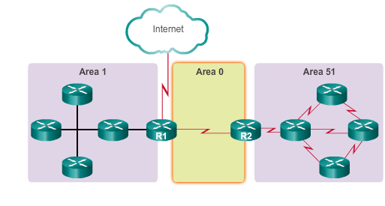
OSPF Two-Layer Area Hierarchy
Multiarea OSPF is implemented in a two-layer area hierarchy:
Backbone (Transit) area -
Area whose primary function is the fast and efficient movement of IP packets.
Interconnect with other OSPF area types
Called OSPF area 0 which all other areas directly connect
Regular (Non-backbone) area -
Connects users and resources
A regular area does not allow traffic from another area to use its links to reach other areas
Notes:
Multiarea OSPF is implemented in a two-layer area hierarchy:
Backbone (Transit) area - Hierarchical networking defines the backbone area or area 0 as the core to which all other areas directly connect. Backbone areas interconnect with other OSPF area types. An OSPF backbone area’s primary function is the fast and efficient movement of IP packets. Generally, end users are not found within a backbone area.
Regular (Non -backbone) area -Connects users and resources. Regular areas are usually set up along functional or geographical groupings. By default, a regular area does not allow traffic from another area to use its links to reach other areas. All traffic from other areas cross area 0.

Slide 19
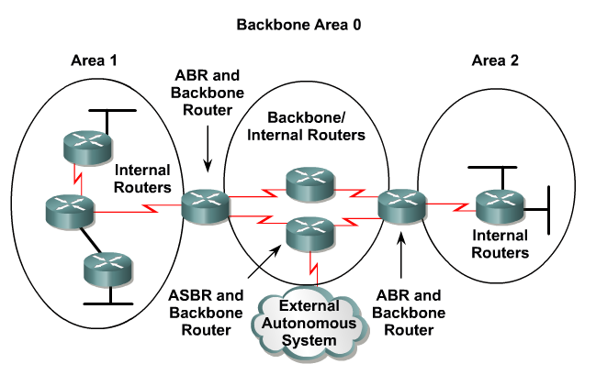
Types of OSPF Routers
Internal Routers
All interfaces in same area
Identical LSDBs
Backbone Routers
At least 1 interface in area 0
Area Border Routers (ABR)
Interfaces in multiple areas
Autonomous System Boundary Routers (ASBR)
At least 1 interface in non-OSPF network
Notes:
There are four different types of OSPF routers:
Internal router – This is a router that has all of its interfaces in the same area. All internal routers in an area have identical LSDBs.
Backbone router – This is a router in the backbone area. Generally, the backbone area is set to area 0.
Area Border Router (ABR) – This is a router that has interfaces attached to multiple areas. It must maintain separate LSDBs for each area it is connected to, and can route between areas. ABRs are exit points for the area, which means that routing information destined for another area can get there only via the ABR of the local area. ABRs can be configured to summarize the routing information from the LSDBs of their attached areas. ABRs distribute the routing information into the backbone. The backbone routers then forward the information to the other ABRs. In a multiarea network, an area can have one or more ABRs.
Autonomous System Boundary Router (ASBR) – This is a router that has at least one interface attached to an external internetwork (another autonomous system), such as a non-OSPF network. An ASBR can import non-OSPF network information to the OSPF network, and vice versa, using a process called route redistribution.
Redistribution in multiarea OSPF occurs when an ASBR connects different routing domains (e.g., EIGRP and OSPF) and configures them to exchange and advertise routing information between those routing domains.
A router can be classified as more than one router type. For example, if a router connects to area 0 and area 1, it falls under two different classifications: a backbone router, and an ABR.

Slide 20
Types of LSAs Exchanged Between Areas

Slide 21
OSPF LSA Types (Revisited)
Notes:
Recall that there are 5 packet types used by OSPF. For OSPF Type 4 Packets, there are 11 LSA types used by OSPF, but only types 1-5 are covered in CCNA. All LSA types are delivered in a Type 4 OSPF Packet.

Slide 22
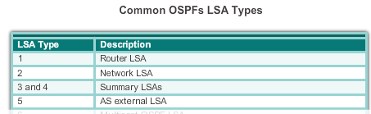
Multiarea OSPF LSA Operation OSPF LSA Types
Notes:
Each router link is defined as an LSA type. The LSA includes a link ID field that identifies, by network number and mask, the object to which the link connects. Depending on the type, the link ID has different meanings. LSAs differ on how they are generated and propagated within the routing domain.

Slide 23
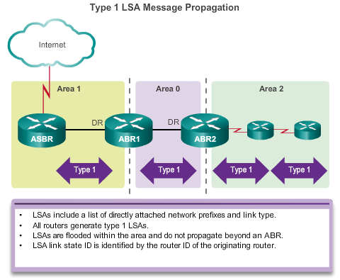
OSPF LSA Type 1 – Router LSA
One router LSA (type 1) for every router in an area
Includes list of directly attached links
Each link identified by IP prefix assigned to link, and link type
Identified by the router ID of the originating router
Floods within its area only; does not cross ABR
Notes:
As shown in the figure, all routers advertise their directly connected OSPF-enabled links in a type 1 LSA and forward their network information to OSPF neighbors. The LSA contains a list of the directly connected interfaces, link types, and link states.
Type 1 LSAs are also referred to as router link entries.
The type 1 LSA link ID is identified by the router ID of the originating router.
Type 1 LSAs are flooded only within the area in which they originated. (ABRs subsequently advertise the networks learned from the type 1 LSAs to other areas as type 3 LSAs.)

Slide 24
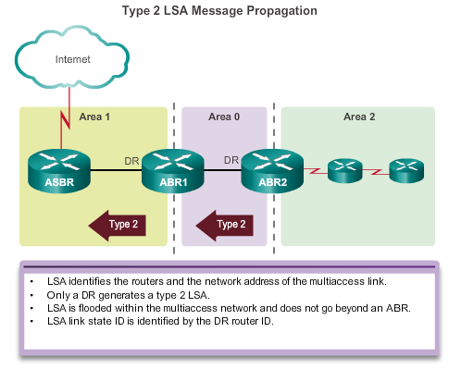
OSPF LSA Type 2 – Network LSA
One router LSA (type 2) LSA for each transit broadcast or NBMA network in an area
Includes list of attached routers on the transit link
Includes subnet mask of link
Advertised by the DR of the broadcast network
Floods within its area only; does not cross ABR
Notes:
A type 2 LSA only exists for multiaccess and non-broadcast multiaccess (NBMA) networks where there is a DR elected and at least two routers on the multiaccess segment.
The DR floods type 2 LSAs only within the area in which they originated. Type 2 LSAs are not forwarded outside of an area.
As shown in the figure, ABR1 is the DR for the Ethernet network in area 1. It generates the type 2 LSA and forwards it into area 1. ABR2 is the DR for the multiaccess network in area 0. There are no multiaccess networks in area 2 and therefore, no type 2 LSAs are ever propagated in that area.

Slide 25
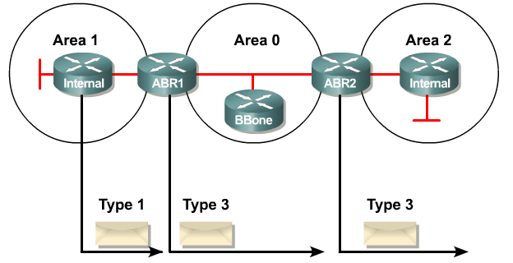
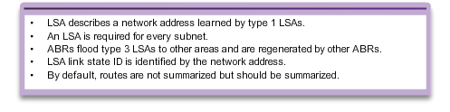
OSPF LSA Type 3 – Summary LSA
Used to flood network information to areas outside the originating area (interarea)
Describes the network number and mask of link
Advertised by the ABR of originating area
Regenerated by subsequent ABRs to flood through the AS
By default, routes are not summarized; Type 3 LSA advertised for every subnet
Notes:
Type 3 LSAs are used by ABRs to advertise networks from other areas. ABRs collect type 1 LSAs in the LSDB. After an OSPF area has converged, the ABR creates a type 3 LSA for each of its learned OSPF networks. Therefore, an ABR with many OSPF routes must create type 3 LSAs for each network.
As shown in the figure, ABR1 and ABR2 floods type 3 LSAs from one area to other areas. The ABRs propagate the type 3 LSAs into other areas. In a large OSPF deployment with many networks, propagating type 3 LSAs can cause significant flooding problems. For this reason, it is strongly recommended that manual route summarization be configured on the ABR.
Receiving a type 3 LSA into its area does not cause a router to run the SPF algorithm. The routes being advertised in the type 3 LSAs are added to or deleted from the router’s routing table, but a full SPF calculation is not necessary.

Slide 26
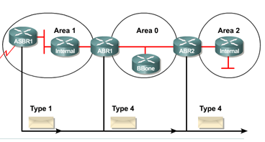
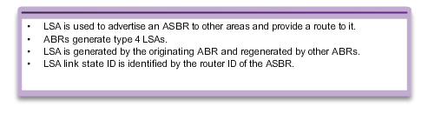
OSPF LSA Type 4 – Summary LSA
Used to advertise an ASBR to all other areas in the AS
Generated by the ABR of the originating area
Regenerated by all subsequent ABRs to flood through out the AS
Contain the router ID of the ASBR
Notes:
Type 4 and type 5 LSAs are used collectively to identify an ASBR and advertise external networks into an OSPF routing domain.
A type 4 summary LSA is generated by an ABR only when an ASBR exists within an area. A type 4 LSA identifies the ASBR and provides a route to it. All traffic destined to an external autonomous system requires routing table knowledge of the ASBR that originated the external routes.
As shown in the figure, ASBR1 sends type 1 LSA router identifying itself as an ASBR. The LSA includes a special bit known as the external bit (e bit) that is used to identify the router as an ASBR. When ABR1 receives the type 1 LSA, it notices the e bit, it builds a type 4 LSA, and then floods the type 4 LSA to the backbone (area 0). Subsequent ABRs flood the type 4 LSA into other areas.

Slide 27
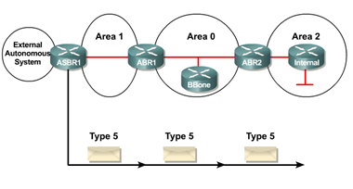
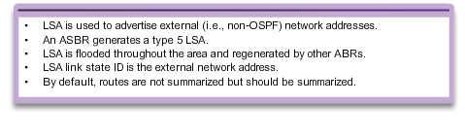
OSPF LSA Type 5 – External LSA
Used to advertise networks from other autonomous systems.
Advertised and owned by originating ASBR
Flood throughout entire AS
Advertising router (ASBR) not changed throughout the AS
Type 4 LSA needed to find ASBR
By default, routes are not summarized
Notes:
Type 5 external LSAs describe routes to networks outside the OSPF autonomous system. Type 5 LSAs are originated by the ASBR and are flooded to the entire autonomous system.
Type 5 LSAs are also referred to as autonomous system external LSA entries.
In the figure, the ASBR generates type 5 LSAs for each of its external routes and floods it into the area. Subsequent ABRs also flood the type 5 LSA into other areas. Routers in other areas use the information from the type 4 LSA to reach the external routes.
In a large OSPF deployment with many networks, propagating multiple type 5 LSAs can cause significant flooding problems. For this reason, it is strongly recommended that manual route summarization be configured on the ASBR.

Slide 28
OSPF LSA Types

Slide 29
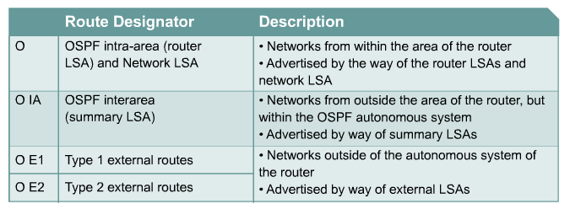
OSPF Routes – Routing Table
Notes:
Routing table entries for OSPF networks will be identified in the routing table based on the area in which they originated in comparison to the router displaying that route.

Slide 30
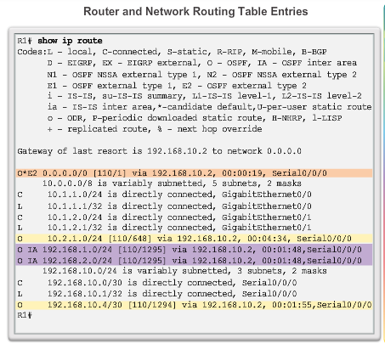
OSPF Routing Table Entries
O - Router (type 1) and network (type 2) LSAs describe the details within an area (the route is intra-area)
O IA - Summary LSAs appear in the routing table as IA (interarea routes)
O E1 or OE 2 - External LSAs external type 1 (E1) or external type 2 (E2)) routes
Notes:
The routing table shows a multiarea OSPF topology with a link to an external non-OSPF network. OSPF routes in an IPv4 routing table are identified using the following descriptors:
O - Router (type 1) and network (type 2) LSAs describe the details within an area. The routing table reflects this link-state information with a designation of O, meaning that the route is intra-area.
O IA - When an ABR receives summary LSAs, it adds them to its LSDB and regenerates them into the local area. When an ABR receives external LSAs, it adds them to its LSDB and floods them into the area. The internal routers then assimilate the information into their databases. Summary LSAs appear in the routing table as IA (interarea routes).
O E1 or O E2 - External LSAs appear in the routing table marked as external type 1 (E1) or external type 2 (E2) routes.

Slide 31
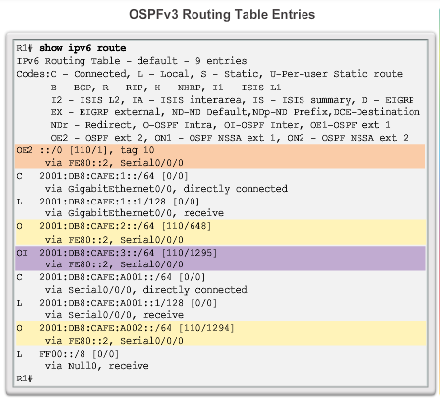
OSPF Routing Table Entries
O - Router (type 1) and network (type 2) LSAs describe the details within an area (the route is intra-area)
OI - Summary LSAs appear in the routing table as IA (interarea routes)
O E1 or OE 2 - External LSAs external type 1 (E1) or external type 2 (E2) routes
Notes:
This figure displays an IPv6 OSPF routing table (OSPFv3) with intra-area, interarea, and external routing table entries.

Slide 32
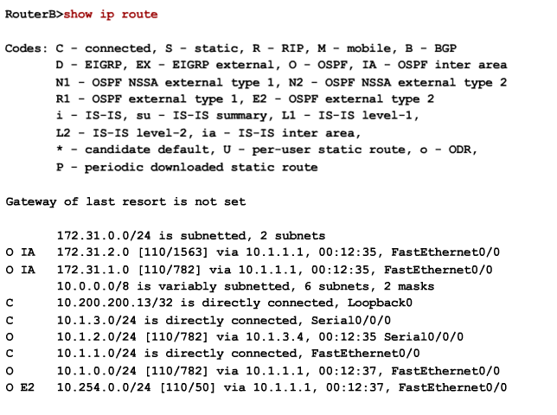
OSPF Routes – Routing Table
External Routes
E2 (default): The cost of O E2 packet routes is just the external cost. Use this type if only one ASBR is advertising an external route to the AS.
E1: Calculate cost by adding the external cost to the internal cost of each link that the packet crosses.
Notes:
E2 routes (the default) do not increment the cost metric for the external route as it propagates through the internal network.
E1 routes add the internal costs to the cost of the external route, allowing OSPF routers to determine the closest ASBR and shortest internal path.

Slide 33
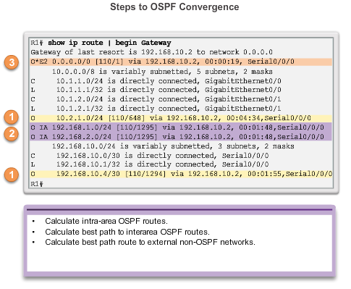
OSPF Route Calculation
All routers calculate the best paths to destinations within their area (intra-area) and add these entries to the routing table.
All routers calculate the best paths to the other areas within the internetwork (interarea) or type 3 and type 4 LSAs.
All routers calculate the best paths to the external autonomous system (type 5) destinations. These are noted with either an O E1 or an O E2 route designator.
Notes:
Each router uses the SPF algorithm against the LSDB to build the SPF tree. The SPF tree is used to determine the best paths.
As shown in the figure, the order in which the best paths are calculated is as follows:
1. All routers calculate the best paths to destinations within their area (intra-area) and add these entries to the routing table. These are the type 1 and type 2 LSAs, which are noted in the routing table with a routing designator of O. (1)
2. All routers calculate the best paths to the other areas within the internetwork. These best paths are the interarea route entries, or type 3 and type 4 LSAs, and are noted with a routing designator of O IA. (2)
3. All routers (except those that are in a form of stub area) calculate the best paths to the external autonomous system (type 5) destinations. These are noted with either an O E1 or an O E2 route designator, depending on the configuration. (3)
When converged, a router can communicate with any network within or outside the OSPF autonomous system.

Slide 34
Configuring Multiarea OSPF

Slide 35
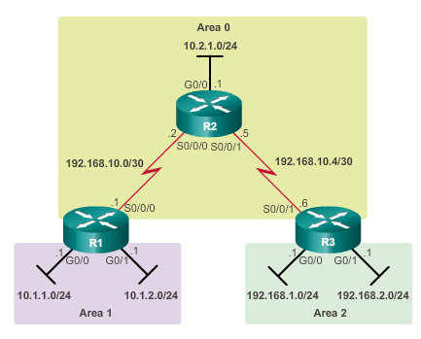
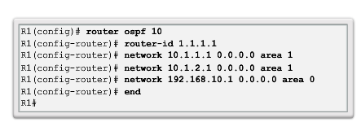
Configuring Multiarea OSPFv2
Notes:
In this example:
R1 is an ABR because it has 2 interfaces in area 1 and an interface in area 0.
R2 is an internal backbone router because all of its interfaces are in area 0.
R3 is an ABR because it has interfaces in area 2 and an interface in area 0.
There are no special commands required to implement this multiarea OSPF network. A router simply becomes an ABR when it has two network statements in different areas.
R1 is assigned the router ID 1.1.1.1. This example enables OSPF on the two LAN interfaces in area 1. The serial interface is configured as part of OSPF area 0. Because R1 has interfaces connected to two different areas, it is an ABR.
Note: The method used for the wildcard mask is one method to configure the wildcard mask (inverse mask). If you use 0.0.0.0 the wildcard mask does not need to be calculated.

Slide 36
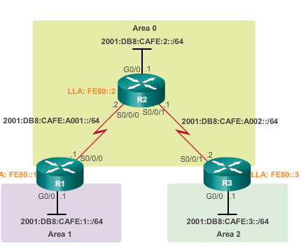
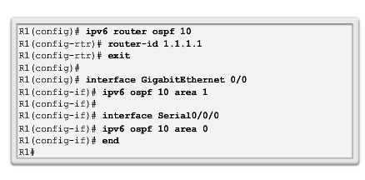
Configuring Multiarea OSPFv3
Notes:
Like OSPFv2, implementing the multiarea OSPFv3 topology is simple. There are no special commands required. A router simply becomes an ABR when it has two interfaces in different areas.
R1 is assigned the router ID 1.1.1.1. The example also enables OSPF on the LAN interface in area 1 and the serial interface in area 0. Because R1 has interfaces connected to two different areas, it becomes an ABR.

Slide 37
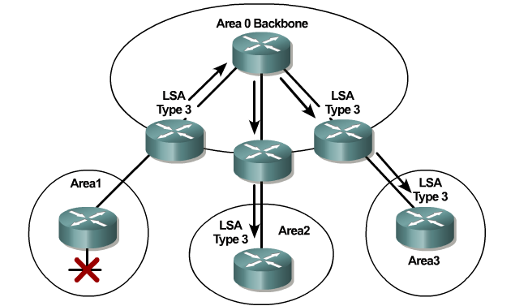
OSPF Route Summarization
Large OSPF Networks – Large number of LSAs sent
All affected OSPF routers have to recompute their LSDB and the SPF tree
Interarea route summarization: Configured on ABRs and applies to routes from within each area
External route summarization: External routes that are injected into OSPF via route redistribution - configured on ASBRs only
Address ranges that are being summarized must be contiguous
Notes:
Summarization helps keep routing tables small. It involves consolidating multiple routes into a single advertisement, which can then be propagated into the backbone area.
Normally, type 1 and type 2 LSAs are generated inside each area, translated into type 3 LSAs, and sent to other areas. If area 1 had 30 networks to advertise, then 30 type 3 LSAs would be forwarded into the backbone. With route summarization, the ABR consolidates the 30 networks into one or two advertisements.

Slide 38
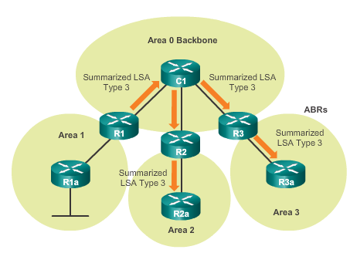
OSPF Route Summarization
R1 forwards a summary LSA to the core router C1.
C1 in turn, forwards the summary LSA to R2 and R3.
R2 and R3 then forward it to their respective internal routers.
Notes:
In the figure, R1 consolidates all of the network advertisements into one summary LSA. Instead of forwarding individual LSAs for each route in area 1, R1 forwards a summary LSA to the core router C1. C1 in turn, forwards the summary LSA to R2 and R3. R2 and R3 then forward it to their respective internal routers.
Summarization also helps increase the network’s stability, because it reduces unnecessary LSA flooding. This directly affects the amount of bandwidth, CPU, and memory resources consumed by the OSPF routing process. Without route summarization, every specific-link LSA is propagated into the OSPF backbone and beyond, causing unnecessary network traffic and router overhead.

Slide 39
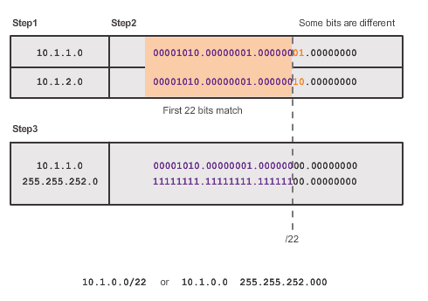
Calculating the Summary Route
Summarize 10.1.1.0/24 and 10.1.2.0/24
10.1.0.0.
Notes:
The figure illustrates that summarizing networks into a single address and mask can be done in three steps:
Step 1. List the networks in binary format. In the example the two area 1 networks 10.1.1.0/24 and 10.1.2.0/24 are listed binary format.
Step 2. Count the number of far left matching bits to determine the mask for the summary route. As highlighted, the first 22 far left matching bits match. This results in the prefix /22 or subnet mask255.255.252.0.
Step 3. Copy the matching bits and then add zero bits to determine the summarized network address. In this example, the matching bits with zeros at the end result in a network address of 10.1.0.0/22. This summary address summarizes four networks: 10.1.0.0/24, 10.1.1.0/24, 10.1.2.0/24, and 10.1.3.0/24.
In the example the summary address matches four networks although only two networks exist.

Slide 40
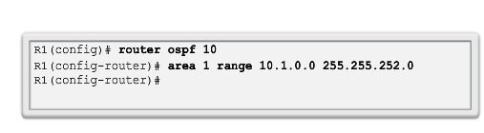
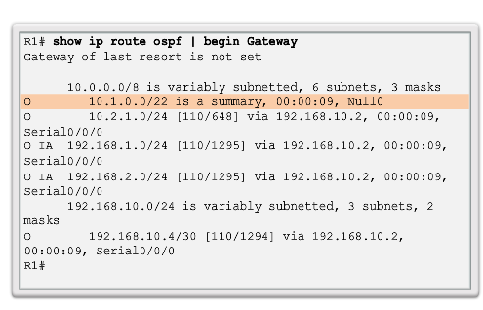
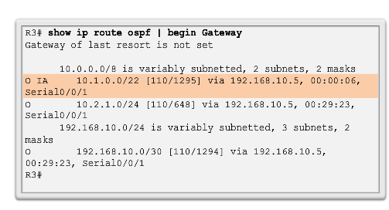
Configuring Interarea Route Summarization
R1
R3
Notes:
The configuration summarizes the two internal area 1 routes, 10.1.0.0/24 to 10.1.3.0/24, into one OSPF interarea summary route on R1. The summarized route 10.1.0.0/22 actually summarizes four network addresses.
Look at the IPv4 routing table of R1. Notice how a new entry has appeared with a Null0 exit interface. The Cisco IOS automatically creates a bogus summary route to the Null0 interface when manual summarization is configured to prevent routing loops. A packet sent to a null interface is dropped.
For example, assume R1 received a packet destined for 10.1.0.10. Although it would match the R1 summary route, R1 does not have a valid route in area 1. Therefore, R1 would refer to the routing table for the next longest match, which would be the Null0entry. The packet would get forwarded to theNull0 interface and dropped. This prevents the router from forwarding the packet to a default route and possibly creating a routing loop.
Take a look at the updated R3 routing table. Notice how there is now only one interarea entry going to the summary route 10.1.0.0/22.

Slide 41
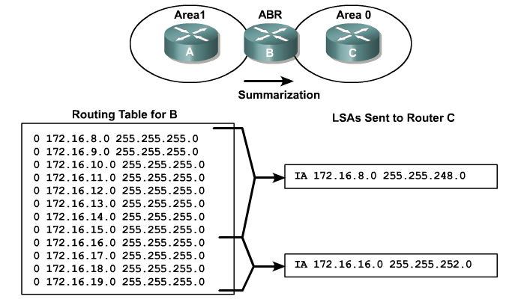
OSPF Route Summarization - VLSM
Notes:
172.16.8.0/24 – 172.16.15.0/24 summarizes as 172.16.8.0/21
172.16.16.0/24 – 172.16.19.0/24 summarizes as 172.16.16.0/22

Slide 42
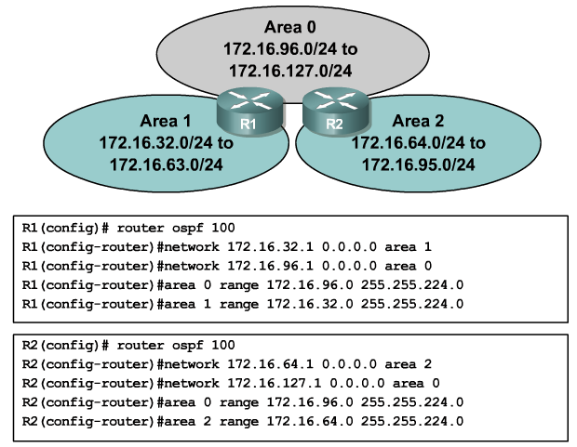
OSPF Interarea Route Summarization
Notes:
Area 0 = 172.16.96.0/24 to 172.16.127.0/24 summarized = 172.16.96.0/27
Area 1 = 172.16.32.0/24 to 172.16.63.0/24 summarized = 172.16.32.0/27
Area 2 = 172.16.64.0/24 to 172.16.95.0/24 summarized = 172.16.64.0/27

Slide 43
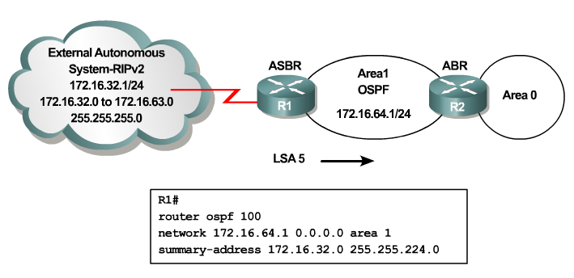
OSPF ASBR Route Summarization
Note - RIPv2 routes must also be redistributed into OSPF in this example
Notes:
The syntax for configuring a Type 5 summary from an ASBR is a little different. In this example, the EXTERNAL RIPv2 172.16.32.0/24 to 172.16.63.0/24 is summarized as 172.16.32.0/27. Notice the syntax for advertising this network to the ABRs.
The configuration shown does not include advertising the routes from RIP into OSPF. The command to do this would be “redistribute rip subnets” in the OSPF configuration. The default metric when redistributing into OSPF is a cost of 20.

Slide 44
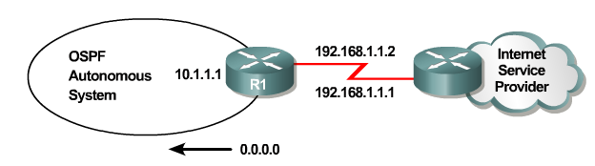
OSPF Default Route
Two methods:
default-information originate
default-information originate always
Key word “always” allows default route to be advertised even if advertising router does not have default route
Optional metric value to indicate preference
Notes:
To generate a default external route into an OSPF routing domain, use the default-information originate command in router configuration mode

Slide 45
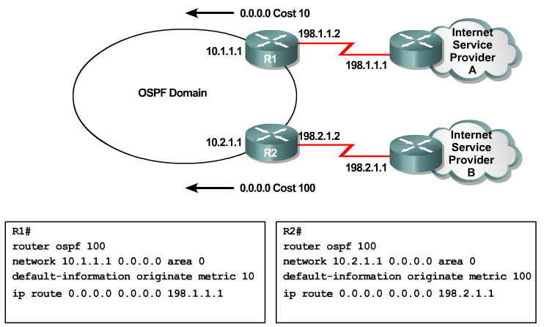
OSPF Default Route Example
Notes:
In this slide, you will see a sample configuration with a default-route pointing to either ISP A or ISP B and the default-information originate command. Notice that one of the options for a wildcard mask in the network statement is simply 0.0.0.0. Entering the network 10.1.1.1 0.0.0.0 area 0 on R1 tells the router to enable the interface for the routing process. As a result, the OSPFv2 process will advertise the network that is on this interface. The advantage of specifying the interface is that the wildcard mask calculation is not necessary. OSPFv2 uses the interface address and subnet mask to determine the network to advertise. As you study for the CCNA, make sure you know both wild-card methods.

Slide 46
Verifying an OSPFv2 and OSPFv3 Configuration

Slide 47
Verifying Multiarea OSPFv2
Commands for verification:
show ip ospf neighbor
show ip ospf
show ip ospf interface
show ip protocols
show ip ospf interface brief
show ip route ospf
show ip ospf database
For OSPFv3 simply substitute ip with ipv6

Slide 48
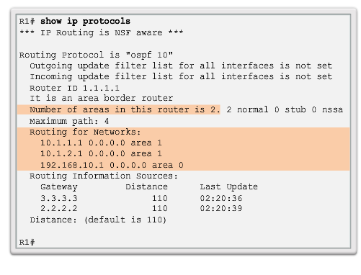
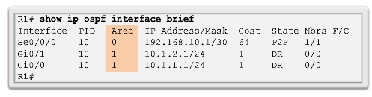
Verifying General Multiarea OSPF Setting
Notes:
Use the show ip protocols command to verify the OSPF status. The output of the command reveals which routing protocols are configured on a router. It also includes routing protocol specifics such as the router ID, number of areas in the router, and networks included within the routing protocol configuration.
The figure displays the OSPF settings of R1. Notice that the command shows that there are two areas. The Routing for Networks section identifies the networks and their respective areas.
Use the show ip ospf interface brief command to display concise OSPF-related information of OSPF-enabled interfaces. This command reveals useful information, such as the OSPF process ID that the interface is assigned to, the area that the interfaces are in, and the cost of the interface.

Slide 49
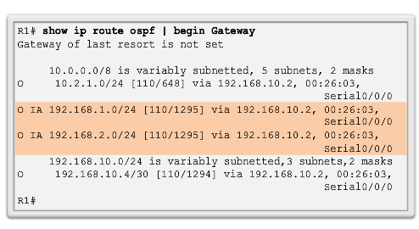
Verify the OSPF Routes
Notes:
The most common command used to verify a multiarea OSPF configuration is the show ip route command. Add the ospf parameter to display only OSPF-related information.
This figure displays the routing table of R1. Notice how the O IA entries in the routing table identify networks learned from other areas. Specifically, O represents OSPF “intra-area” routes, and IA represents interarea, which means that the route originated from another area. The [110/1295] entry in the routing table represents the administrative distance that is assigned to OSPF (110) and the total cost of the routes (cost of 1295).

Slide 50
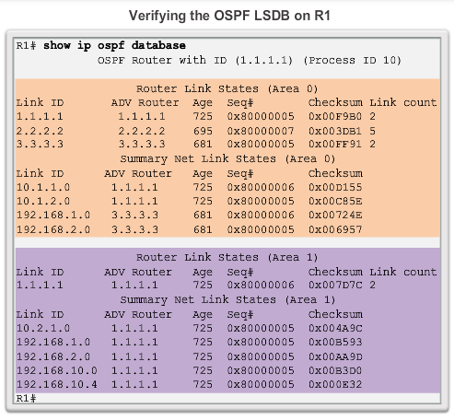
Verify the Multiarea OSPF LSDB
Notes:
Ths show ip ospf database command is another useful command for verification. It is used to verify the OSPF LSDB.

Slide 51
OSPF Key Points

Slide 52

Chapter 8: Summary
Multiarea OSPF:
Better choice for larger network than single-area
Solves the issues of large routing tables, large link-state databases, and frequent SPF algorithm calculations
Main area is called the backbone area (area 0)
Recalculating the database is kept within an area
Four different types of OSPF routers:
Internal router
Backbone router
Area Border Router (ABR)
Autonomous System Boundary Router (ASBR)
A router simply becomes an ABR when it has two network statements in different areas
Notes:
Chapter 8 Summary

Slide 53
Chapter 8: Summary
Multiarea OSPF:
Link State Advertisements (LSAs) are the building blocks of OSPF
Type 1 LSAs are referred to as the router link entries
Type 2 LSAs are referred to as the network link entries and are flooded by a DR
Type 3 LSAs are referred to as the summary link entries and are created and propagated by ABRs
A type 4 summary LSA is generated by an ABR only when an ASBR exists within an area
Type 5 external LSAs describe routes to networks outside the OSPF autonomous system, originated by the ASBR and are flooded to the entire autonomous system
SPF tree is used to determine the best paths
OSPF routes in an IPv4 or IPv6 routing table are identified using the following descriptors: O, O IA (OI), O E1 or O E2.
Notes:
Chapter 8 Summary

Slide 54
Chapter 8: Summary
Multiarea OSPF:
An example of multiarea OSPFv2 configuration:
R1(config)#router ospf 10
R1(config-router)#router-id 1.1.1.1
R1(config-router)#network 10.1.1.0 0.0.0.15 area 1
R1(config-router)#network 10.1.2.0 0.0.0.3 area 1
R1(config-router)#network 192.168.10.1 0.0.0.0 area 0
Does not perform auto summarization but can be manually configured using the area X range or summary-address router configuration command
Notes:
Chapter 8 Summary

Slide 55
Chapter 8: Summary
Multiarea OSPFv2:
Commands that are used to verify OSPF configuration consist of the following:
show ip ospf neighbor
show ip ospf
show ip ospf interface
show ip protocols
show ip ospf interface brief
show ip route ospf
show ip ospf database
Notes:
Chapter 8 Summary

Slide 56

Packet Tracer Activity
Created by Lonnie Decker
Department Chair
Davenport University

Slide 57
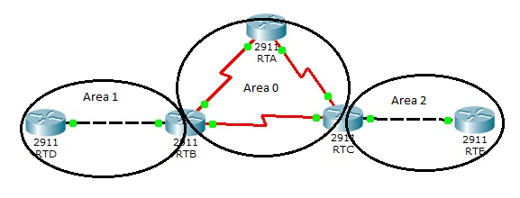
Multi-area OSPF Practice Lab
RTB – RTD – 192.168.0.0/24 RTA – RTB – 10.1.1.0/30 RTC – RTE – 192.168.4.0/24
RTD Lo0 – 192.168.1.0/24 RTA – RTC – 10.1.1.4/30 RTE Lo0 – 192.168.5.0/24
RTB – RTC – 10.1.1.8/30
RTA Lo0 - Internet – 172.16.1.0/24

Slide 59


